Slide 1
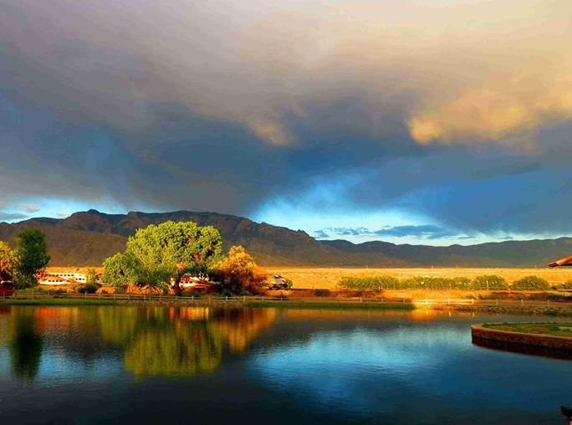
Sandia Lakes
PAVILION
Make your event special at…

Slide 2

FEATURES:
PRIVATE LAKE
SPECTACULAR VIEWS
CEREMONY AND RECEPTION FOR UP TO 250 GUESTS
COVERED PAVILION
COMMERCIAL KITCHEN
14, 6’ TABLES
2 BUILT IN COMMERCIAL BARBEQUE GRILLS
FREE PARKING
ONE HOUR WEDDING REHEARSAL (based on time availability)
FREE SHUTTLE FROM SANDIA RESORT FOR RESORT GUESTS
Additional FEE Options
150 WHITE CEREMONY RENTAL CHAIRS
LIVE BANDS AND/OR DJ’S ALLOWED
PRIVATE CATERING ALLOWED
BAR OPTIONS AVAILABLE PLEASE INQUIRE

Slide 3
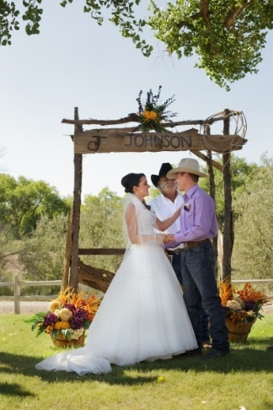
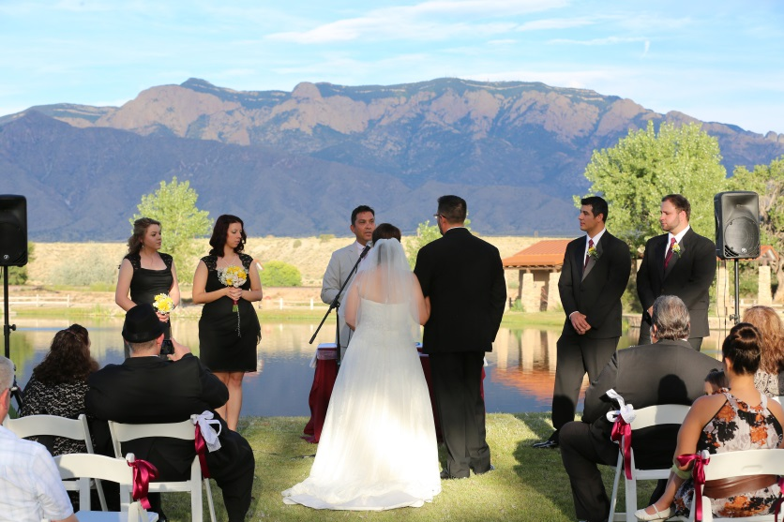
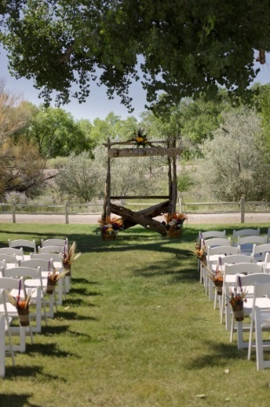
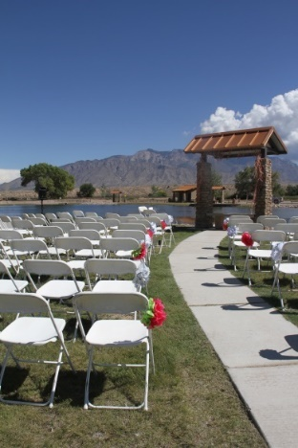
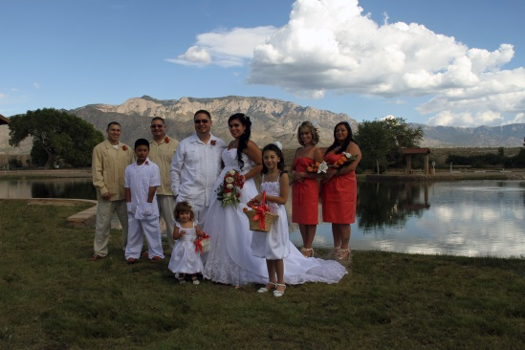
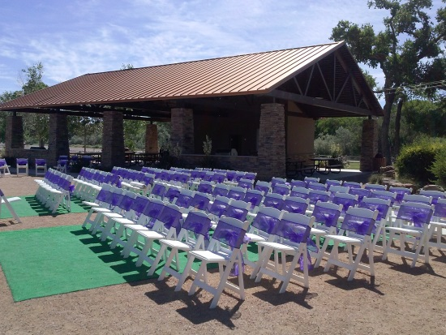
WEDDINGS
c
A breathtaking backdrop makes our pavilion the perfect setting for your keepsake photos and memories that will last a lifetime.

Slide 4
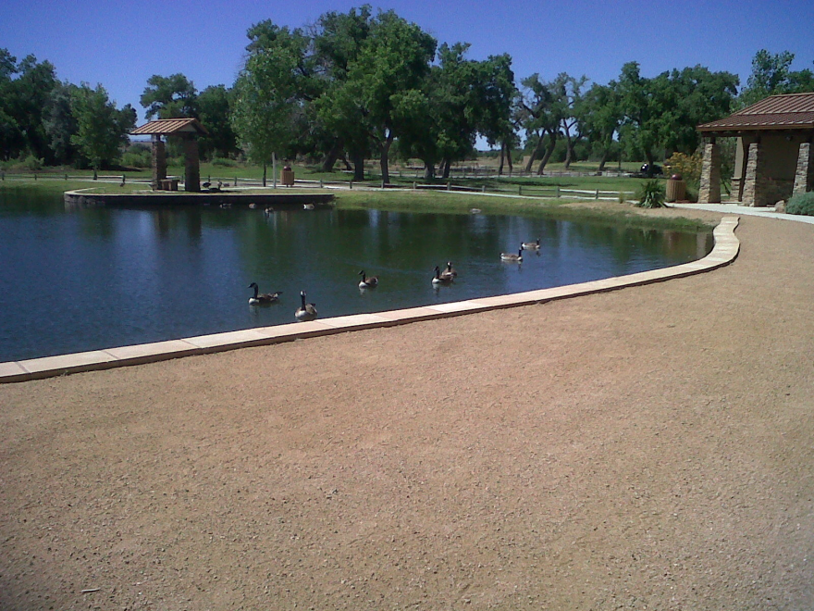
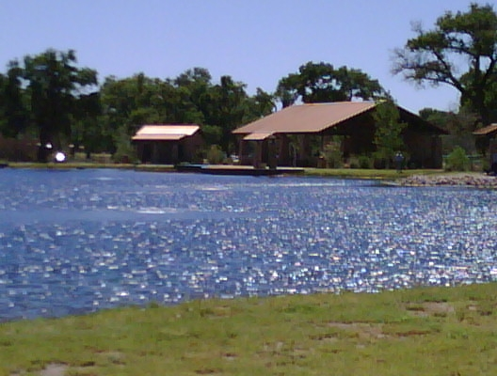
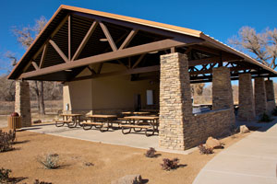
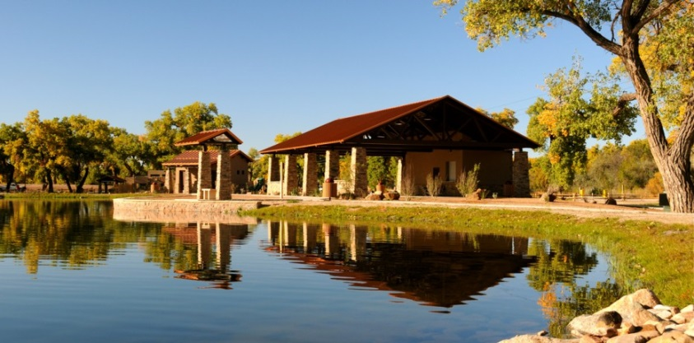
FAMILY REUNIONS
Make it a special party for the family with all the space and outdoor fun for everyone.

Slide 5

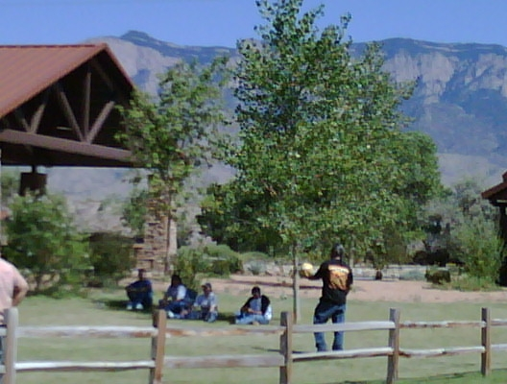
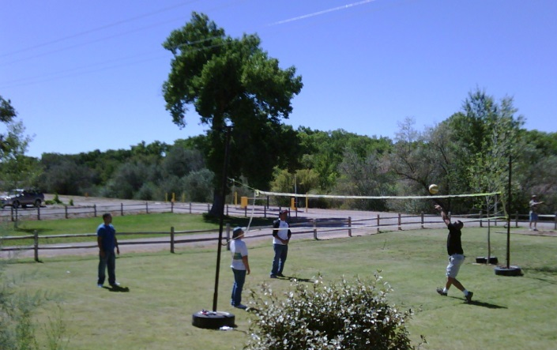
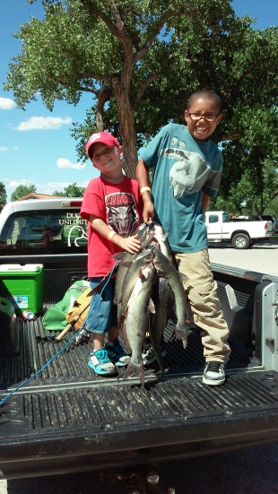
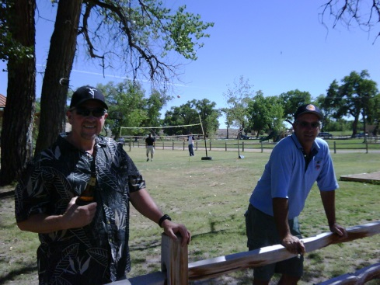
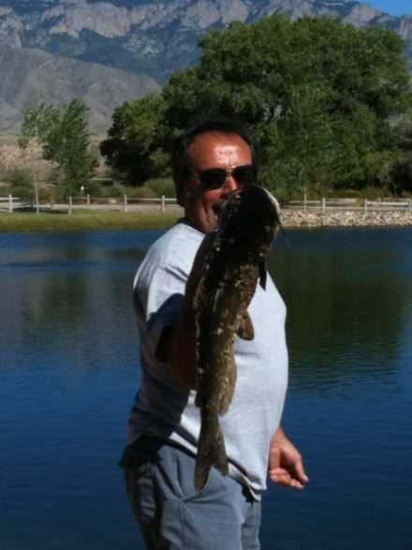
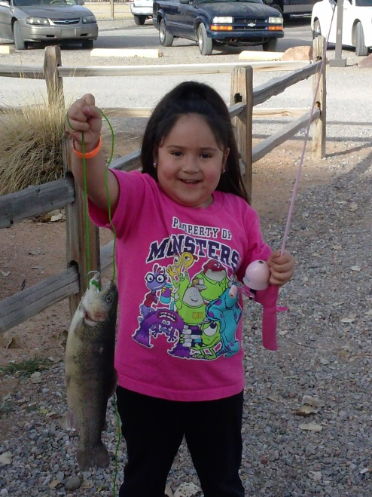
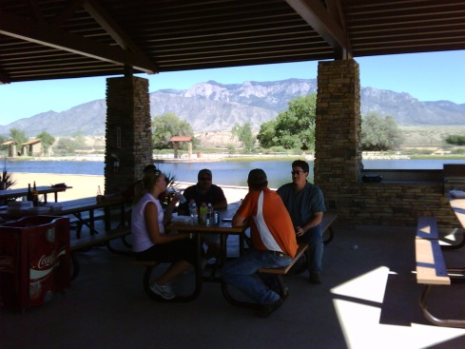
COMPANY PICNICS
Throw a unique party for your company. Sandia Lakes is perfect for the entire family.

Slide 6
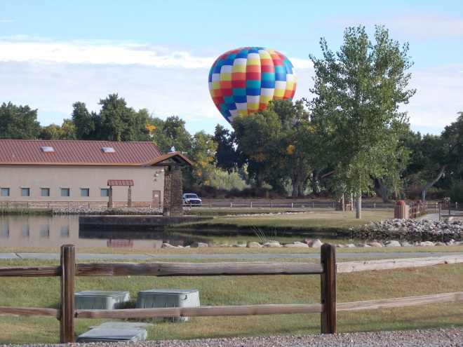
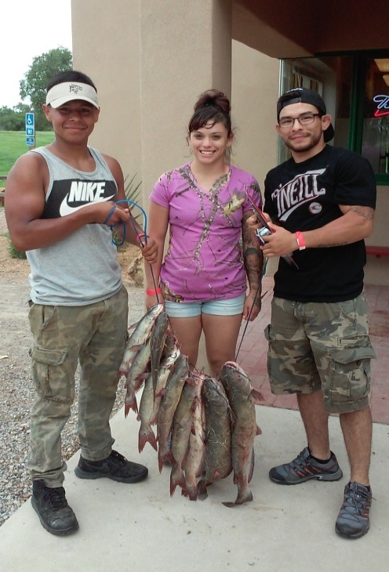
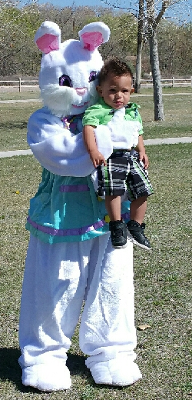
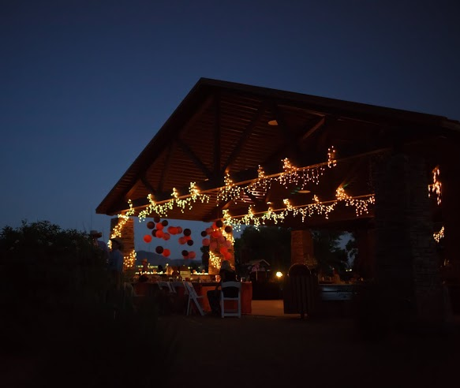
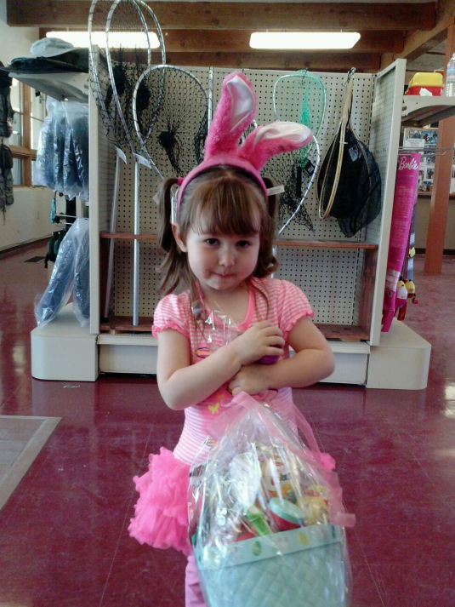

HOLIDAYS & GATHERINGS

Slide 7
MAIN PAVILION PRICING
Summer Full Day Rates 9:00am – 7:00pm 7:00pm – 10:00pm
Up to 150 Guests $1,150.00 $100.00 PER HOUR
151 to 200 Guests $1,250.00 $100.00 PER HOUR
201 to 250 Guests $1,350.00 $100.00 PER HOUR
Summer Hourly Rate (4 hour min) 9:00 am – 7:00pm 7:00pm – 10:00pm
Up to 150 Guests $175.00 $175.00 PER HOUR
151 to 200 Guests $200.00 $175.00 PER HOUR
201 to 250 Guests $250.00 $175.00 PER HOUR
Winter Full Day Rate October 1st Thru April 1st 9:00 am – 5:00pm 5:00pm – 7:00pm
Up to 150 Guests $950.00 $150.00 PER HOUR
151 to 200 Guests $1000.00 $150.00 PER HOUR
201 to 250 Guests $1075.00 $150.00 PER HOUR
Winter Hourly Rate October 1st Thru April 1st 9:00 am – 5:00pm 5:00pm – 7:00pm
Up to 150 Guests $150.00 $175.00 PER HOUR
151 to 200 Guests $175.00 $175.00 PER HOUR
201 to 250 Guests $200.00 $200.00 PER HOUR
Ceremony garden chairs (150) $225.00
Rehearsals (1 hour) are based on time availability we do not guarantee use of Pavilion for rehearsals.
*Check in and out times include your set up and clean up time.
**Prices do not include tax.
***Fishing permits are sold separately. Please inquire on permit pricing.
Prices effective January 2020

Slide 8
PARTY PAVILION
Full Day Rate 400.00
SANDIA LAKES PARTY PAVILION IS A GREAT SPACE FOR YOUR FAMILY REUNION, BIRTHDAY PARTIES, COMPANY COOK-OUTS OR SUMMER GATHERINGS
PARTY PAVILION COMES EQUIPPED WITH ELECTRICITY, 6 -6’ PICNIC TABLES AND A GAS GRILL.
PARKING AREA, RESTROOMS, HORSESHOE PIT AND PLAYGROUND INCLUDED. PLEASE REMEMBER ALL ALCOHOL MUST BE PURCHASED IN OUR STORE, NO OUTSIDE ALCOHOL.
Pricing is for 75 guests, please inquire about pricing for additional guests.
Full day rate is 9am-6pm (summer hours)
A $200.00 DEPOSIT IS REQUIRED TO RESERVE A DATE FOR THE PARTY PAVILION.
*Check in and out times include your set up and clean up time.
**Prices do not include tax.
***Fishing permits are sold separately. Please inquire on permit pricing.
***Please inquire pricing for additional guests

Slide 9


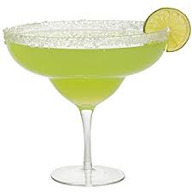
SANDIA LAKES ADULT BEVERAGES
GUESTS ARE NOT PERMITTED TO BRING ALCOHOLIC BEVERAGES ON TO SANDIA LAKES PROPERTY.
SET-UP FEE FOR BAR 75.00
PLEASE INQUIRE
BEVERAGE MINIMUM REQUIRED
A 350.00 BEVERAGE MINIMUM IS REQUIRED FOR SERVICE. IF MINIMUM IS NOT MET A 100.00 BARTENDER FEE WILL BE ADDED
Please call 771-5190 to schedule your special event

